Slide 1


Abstract Classes and Interfaces in Java
In Java, abstract classes and interfaces are powerful tools for creating robust, modular, and extensible software. These language features enable developers to define common behavior, promote code reuse, and enforce consistent interfaces across related classes.
by Roshika Kumaravel

Slide 2

What is an Abstract Class?
1
Partially Implemented
2
Non-Instantiable
An abstract class can contain both abstract methods and concrete methods.
Abstract classes cannot be directly instantiated, they must be extended by concrete subclasses.
3
Common Behavior
Abstract classes are used to define and share common behavior among related classes.

Slide 3
Key Features of Abstract Classes
Inheritance
Access Modifiers
Concrete Methods
Abstract classes support single inheritance, allowing a class to extend only one abstract class.
Abstract classes can have public, protected, or private access modifiers for their members.
Abstract classes can provide concrete method implementations to be shared by subclasses.

Slide 4
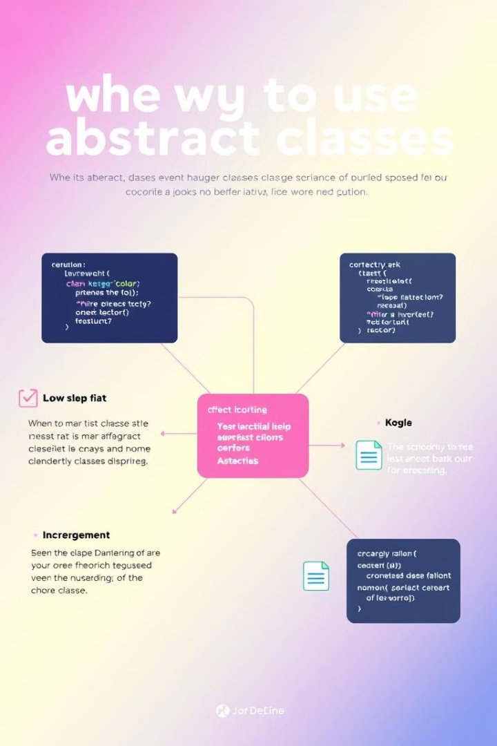
When to use Abstract Classes
Common Behavior
Partial Implementation
Abstract classes are useful when you have a group of related classes that share common behavior.
Use abstract classes when you want to provide some default implementation, but leave certain methods unimplemented.
Hierarchical Relationships
Code Reuse
Abstract classes enable code reuse by sharing common implementation details across subclasses.
Abstract classes are appropriate when you have a clear hierarchical relationship between classes.

Slide 5

What is an Interface?
1
Purely Abstract
2
Multiple Inheritance
3
Loose Coupling
Interfaces are purely abstract; they can only contain abstract methods and static constants.
Classes can implement multiple interfaces, enabling a form of multiple inheritance.
Interfaces define a contract, allowing classes to be loosely coupled and easily interchangeable.

Slide 6
Key Features of Interfaces
Abstract Methods
Static Methods
Default Methods
All methods in an interface are implicitly abstract and public, even if not explicitly declared.
Interfaces can now contain static utility methods, in addition to abstract instance methods.
Interfaces can provide default method implementations, allowing for backwards compatibility.

Slide 7
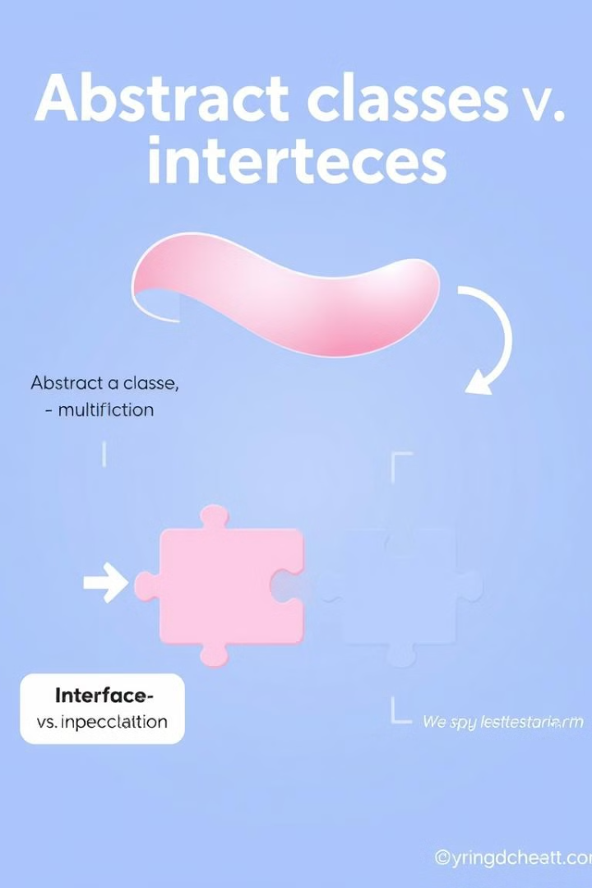
Differences between Abstract Classes and Interfaces
Instantiation
Inheritance
Abstract classes can have concrete methods, while interfaces contain only abstract methods.
Classes can extend only one abstract class, but can implement multiple interfaces.
Access Modifiers
State
Abstract classes can use any access modifier, while interfaces only allow public members.
Abstract classes can have instance variables, while interfaces can only have static constants.

Slide 8
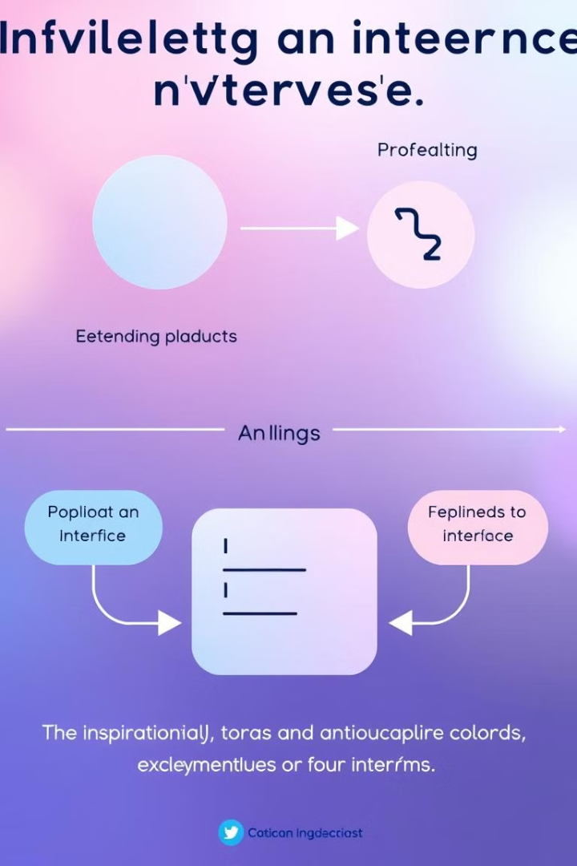



Implementing Interfaces vs. Extending Abstract Classes
Flexibility
Interfaces provide more flexibility, allowing a class to implement multiple interfaces.
Code Reuse
Abstract classes enable code reuse by providing common concrete method implementations.
Constraints
Abstract classes impose more constraints, as a class can only extend one abstract class.

Slide 9
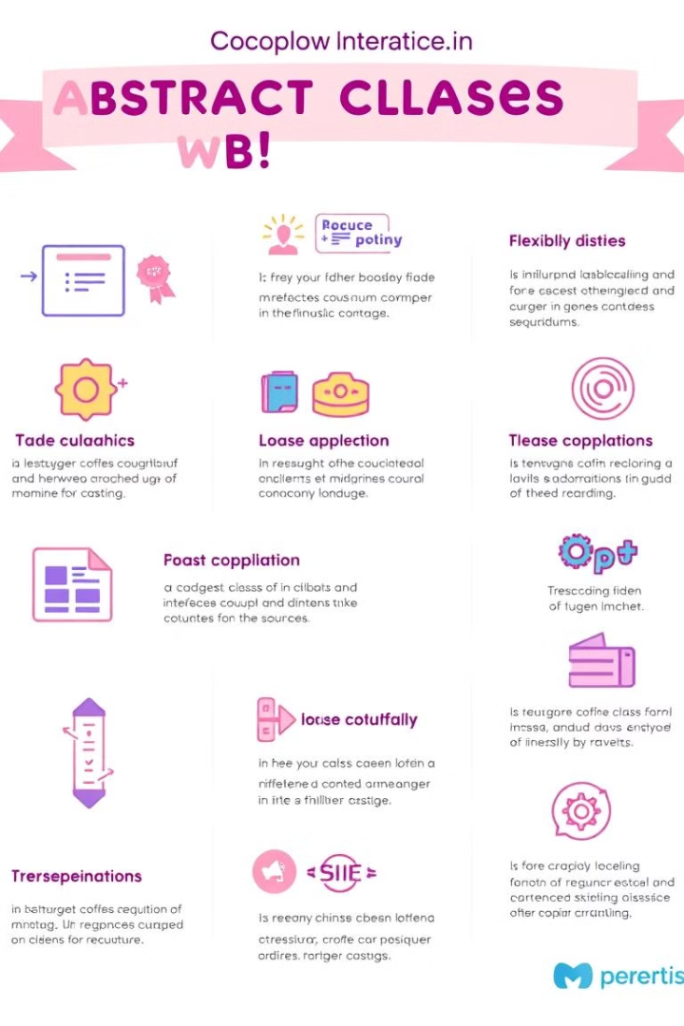




Benefits of using Abstract Classes and Interfaces
Code Reuse
Abstraction
Abstract classes and interfaces promote code reuse by defining common behavior.
They provide a way to abstract away implementation details and focus on the contract.
Extensibility
Polymorphism
Interfaces enable extensible and loosely coupled designs that are easy to maintain.
Abstract classes and interfaces support polymorphism, allowing for dynamic binding.

Slide 10
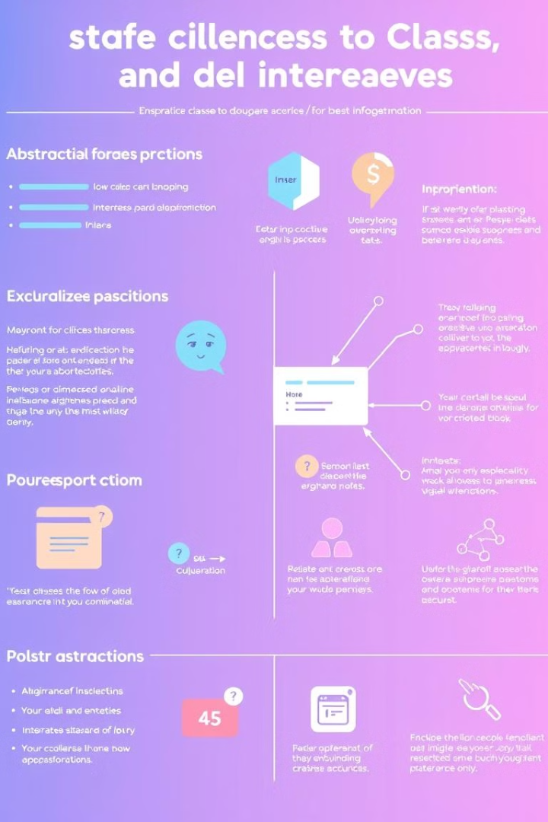
Best Practices and Recommendations
Prefer interfaces over abstract classes when possible
Interfaces promote loose coupling and flexibility
Use abstract classes when you need to share common state or behavior
Abstract classes enable code reuse and partial implementation
Leverage default methods in interfaces for backwards compatibility
Default methods allow you to add new functionality without breaking existing code
Avoid mixing abstract and concrete methods in the same interface
Interfaces should be purely abstract to maintain a clear contract

